Slide 1
Who was Ramon Folch?
Escola Valeri Serra
Bellpuig
2021

Slide 2
CONTEXTUALIZATION
Students will meet an important figure of our town (Bellpuig), Ramon Folch.
Students will establish hypotheses by answering the initial question.
Then, they will develop a cooperative research work looking for information and testing their hypotheses.
At the end of the project, students will design a digital presentation and will present it to other students in the school.

Slide 3
AREAS
We focus on History area.
Taking into account the different areas of the primary education stage. Cross - curricular.

Slide 4
WHO? WHEN? HOW?
Student of 3th grade.
10 sessions during the second term.
Open and flexible.

Slide 5
AIMS
To design a digital presentation about Ramon Folch.
Explain how the inhabitants of Bellpuig lived in the Middle Ages.
To participate in cooperative activities and in large groups valuing one's own and others' contributions in a democratic way.

Slide 6
IMPORTANT!
Educational inclusion.
Activities that fit the group of students you are working with.
Universal inclusive measures: Peer help, brainstorm…
Using IT resources.

Slide 7
METHODOLY
The starting point of the project will be a question. This question will be open.
The didactic sequence is structured according to the scientific method. It is based on previous knowledge and Hypotheses.
The three typologies of contents will be worked on: conceptual, procedural and attitudinal.
There are activities of different types (information search, exercises, application, experimentation, production ...)

Slide 8
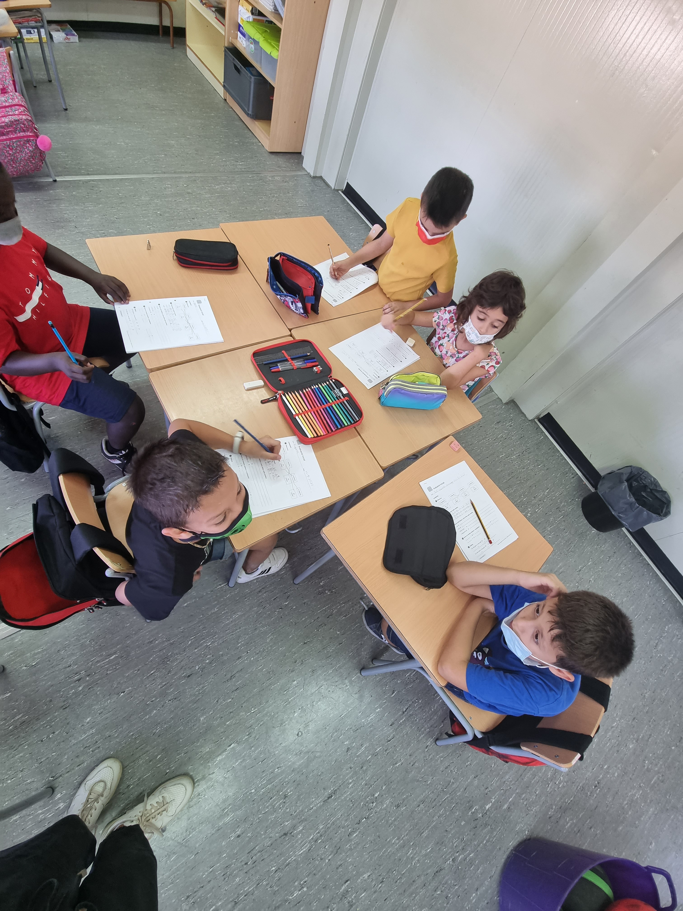
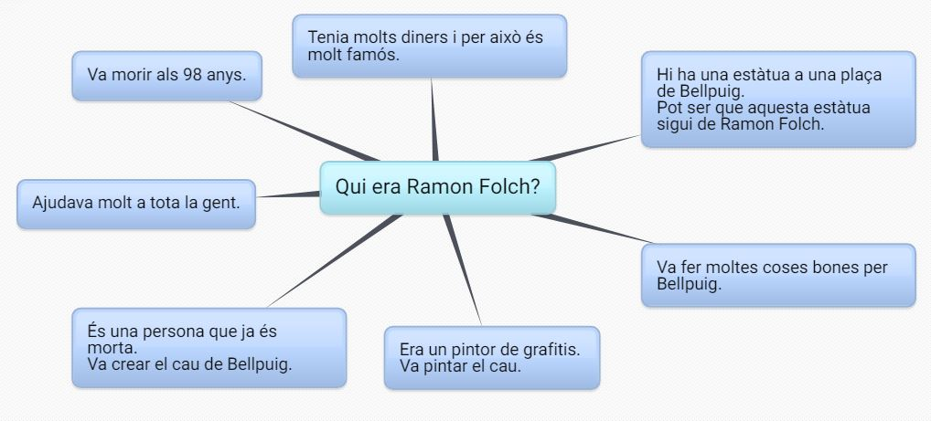
SESSION 1 AND 2
SESSION 1
THE QUESTION. The previous ideas will be reflected in a concept map that will be modified during the project. https://bubbl.us/
BRAIN STORM.
SESSION 2
In groups, each one will write their HYPOTHESIS answering the question of the unit

Slide 9
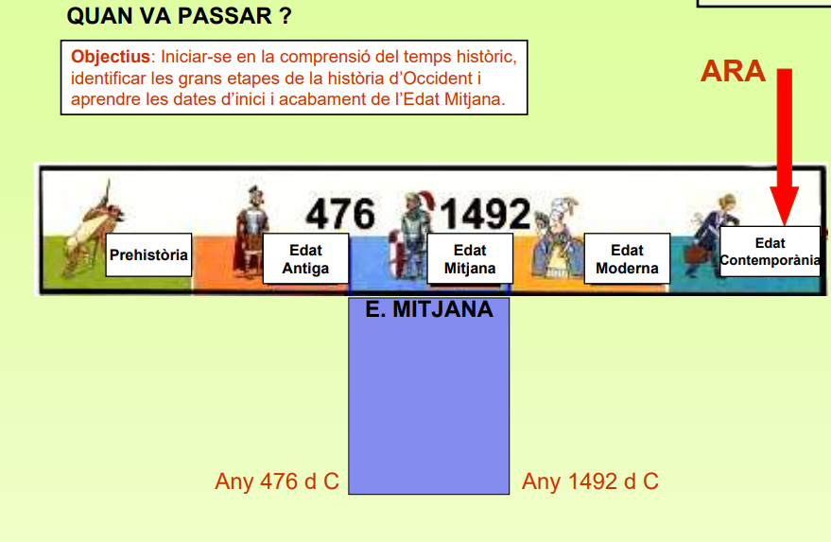
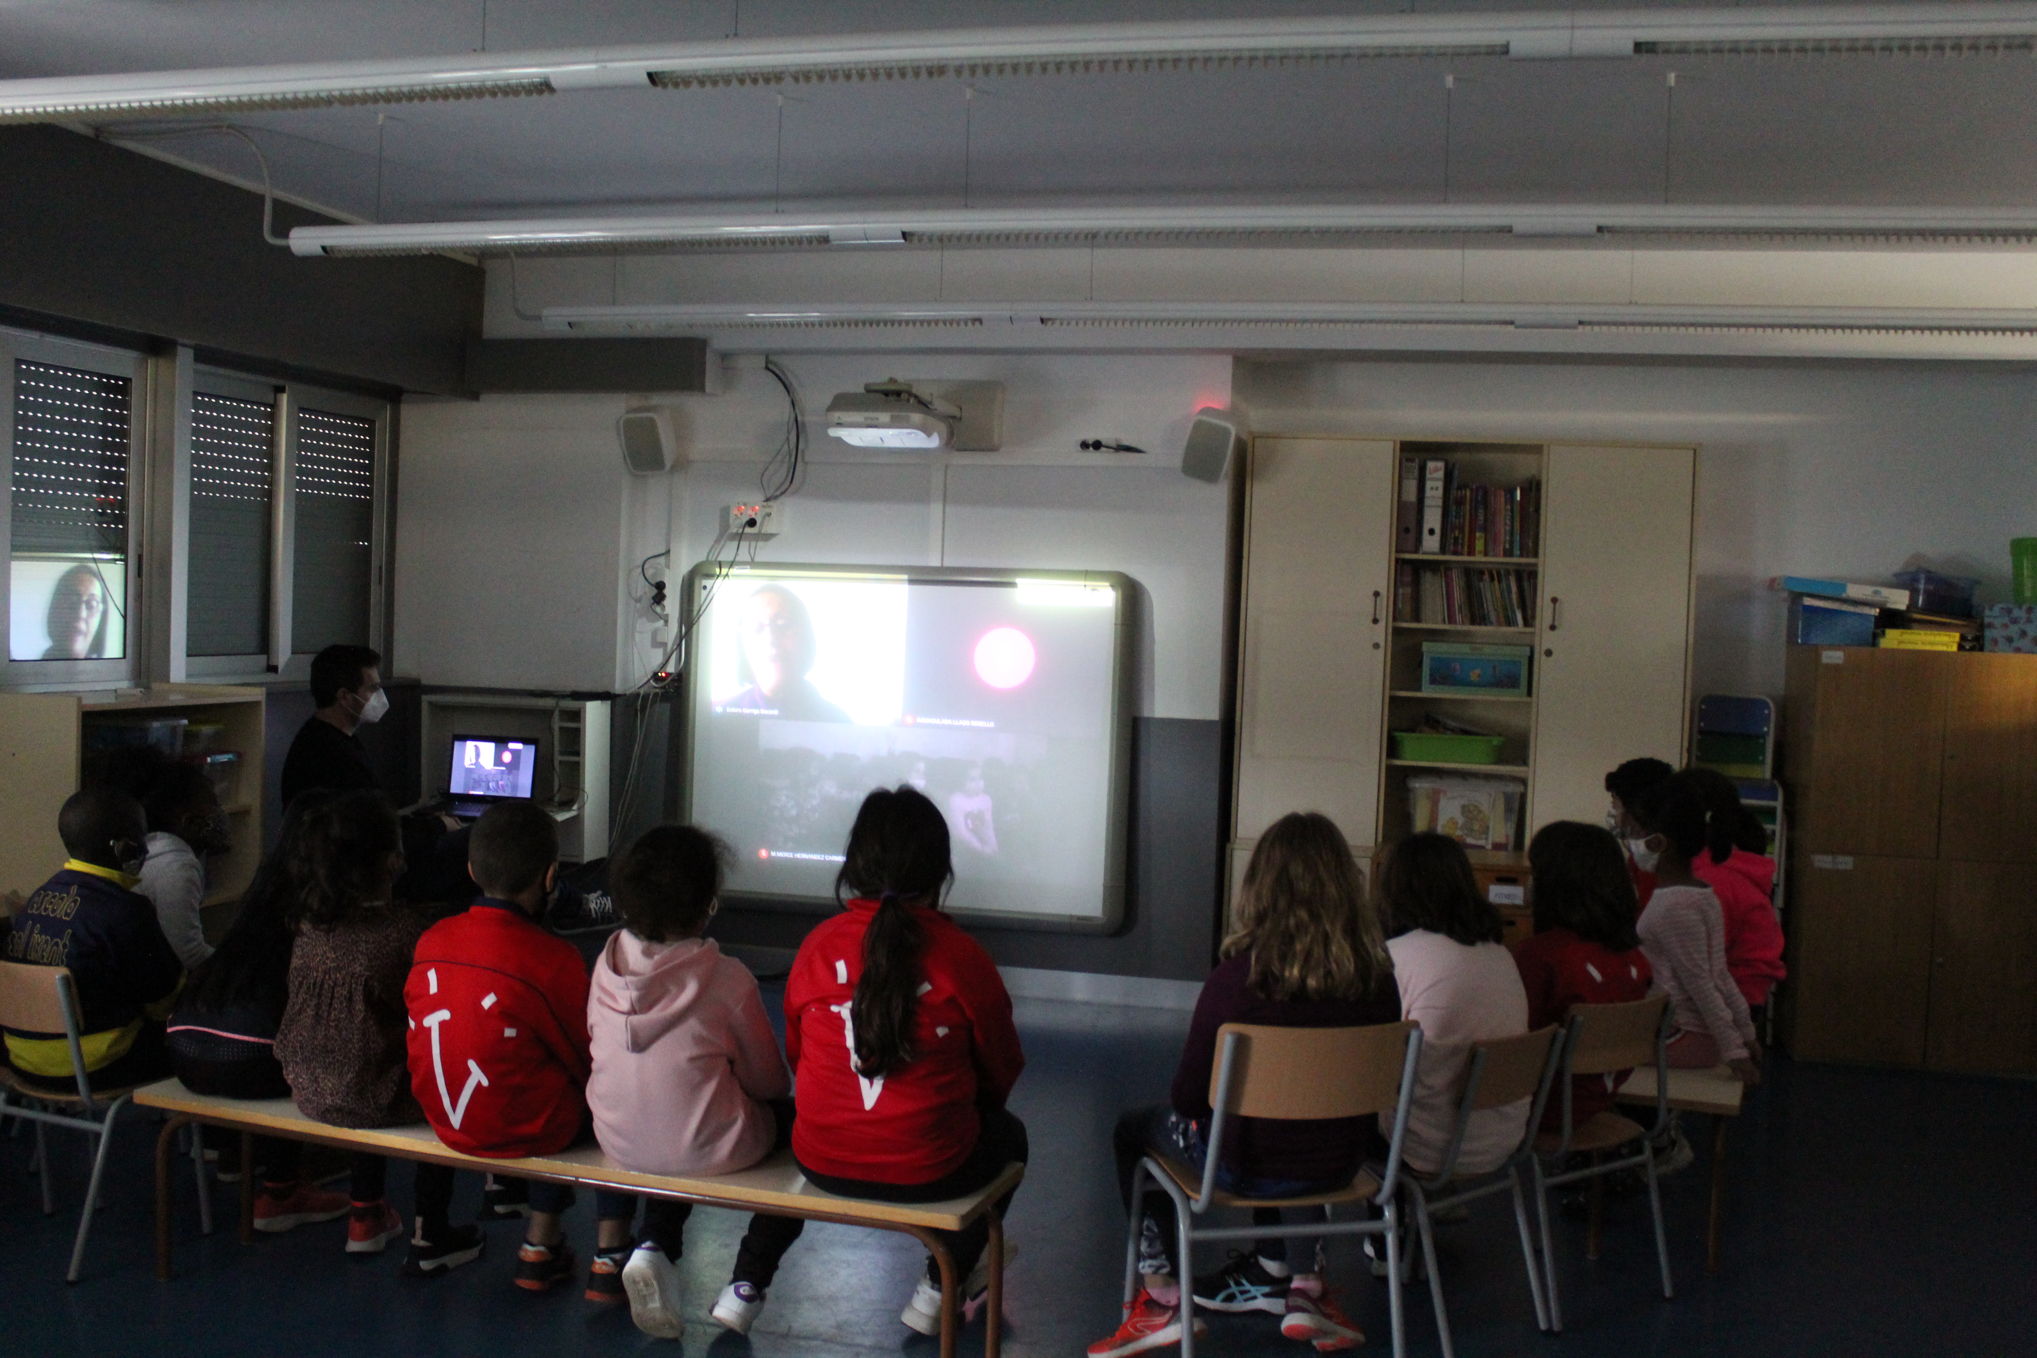
SESSION 3 AND 4
SESSION 3
Information to students.
share key information in groups.
Added to the concept map.
SESSION 4
Watch a video.
Write the key information of the video.

Slide 10
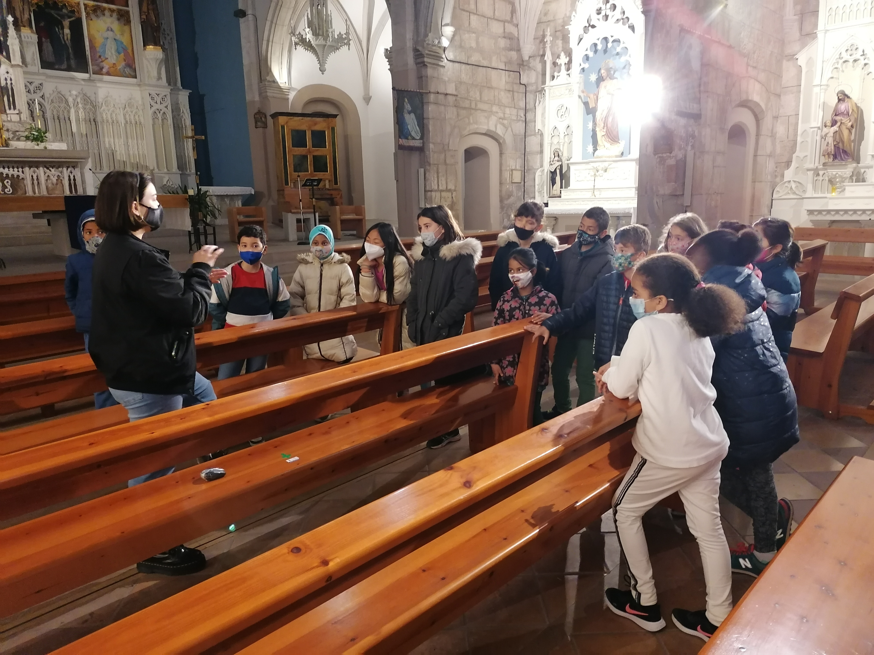
SESSION 5 AND 6
SESSION 5
In groups, students will read and analyze the information about this character.
Then, we will share the new information with the whole group and we will include it in our concept map.
SESSION 6
We will visit the Mausoleum of Ramon Folch located in the church of Bellpuig.

Slide 11
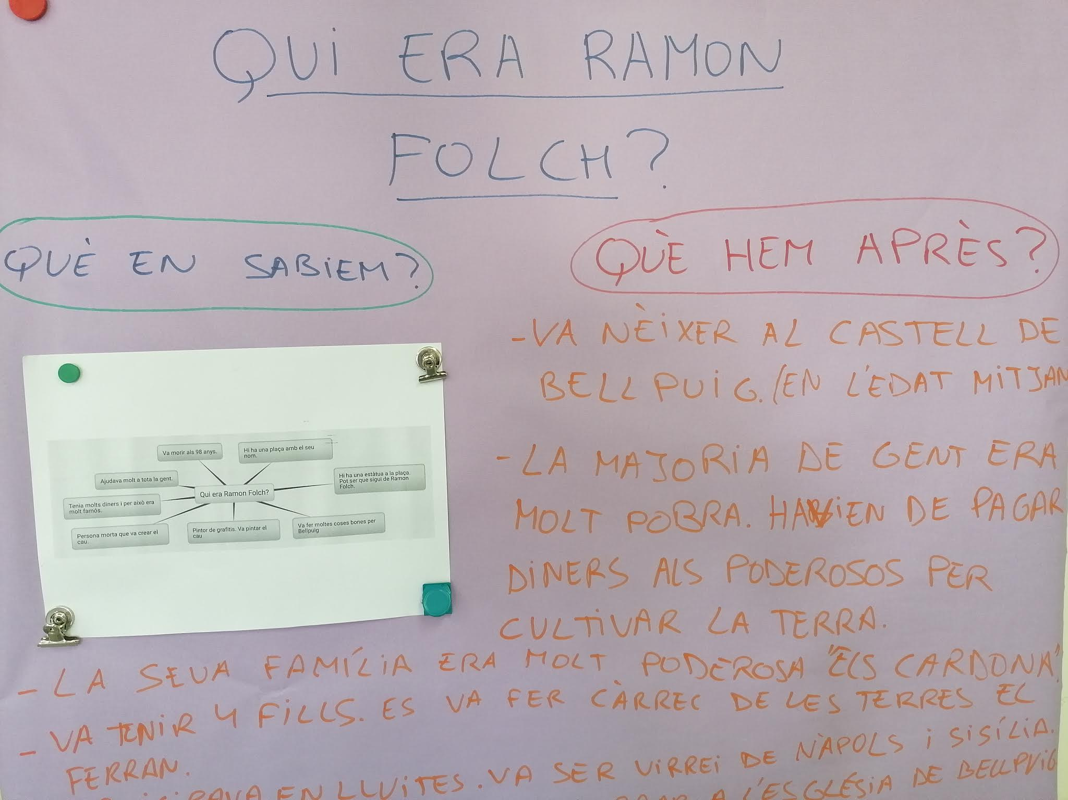
SESSION 7, 8 AND 9
SESSION 7
Include the new information about Ramon Folch that we learned.
Will have to review their hypothesis .
Will write their conclusions.
SESSION 8 AND 9
In groups, students will design a digital presentation.

Slide 12
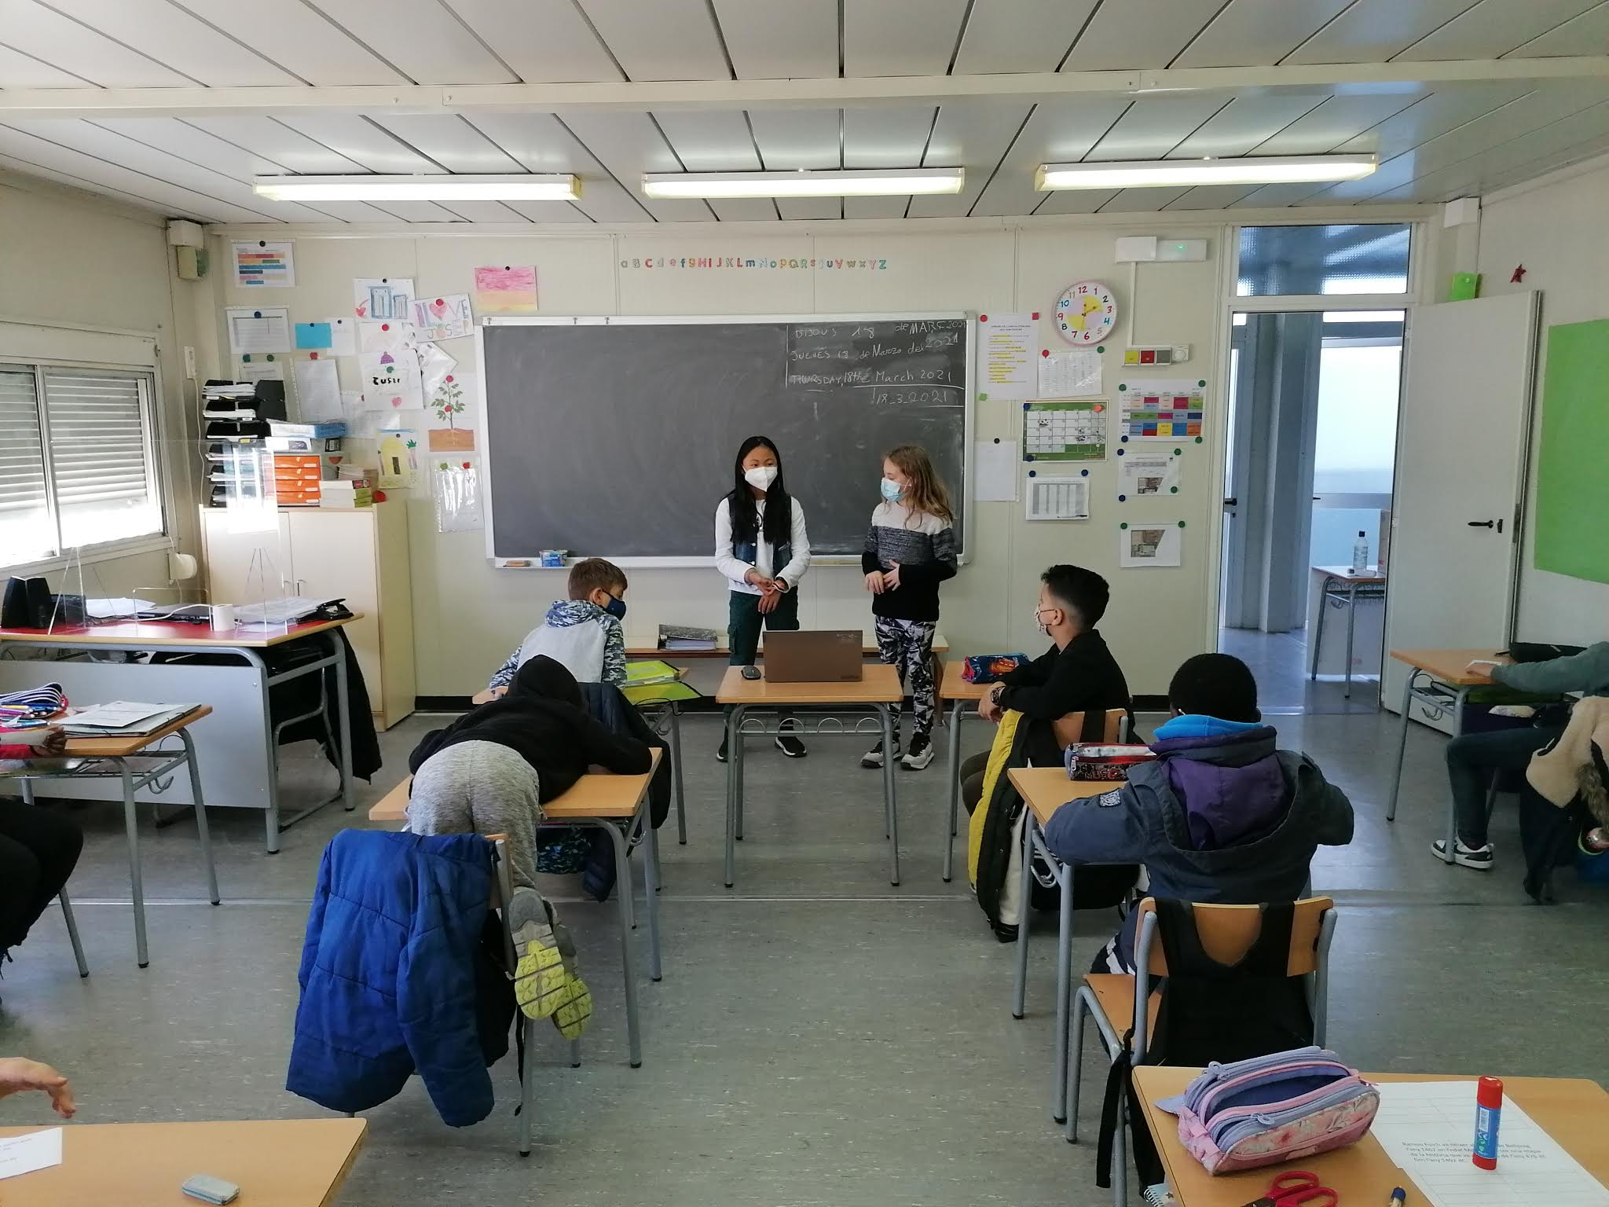
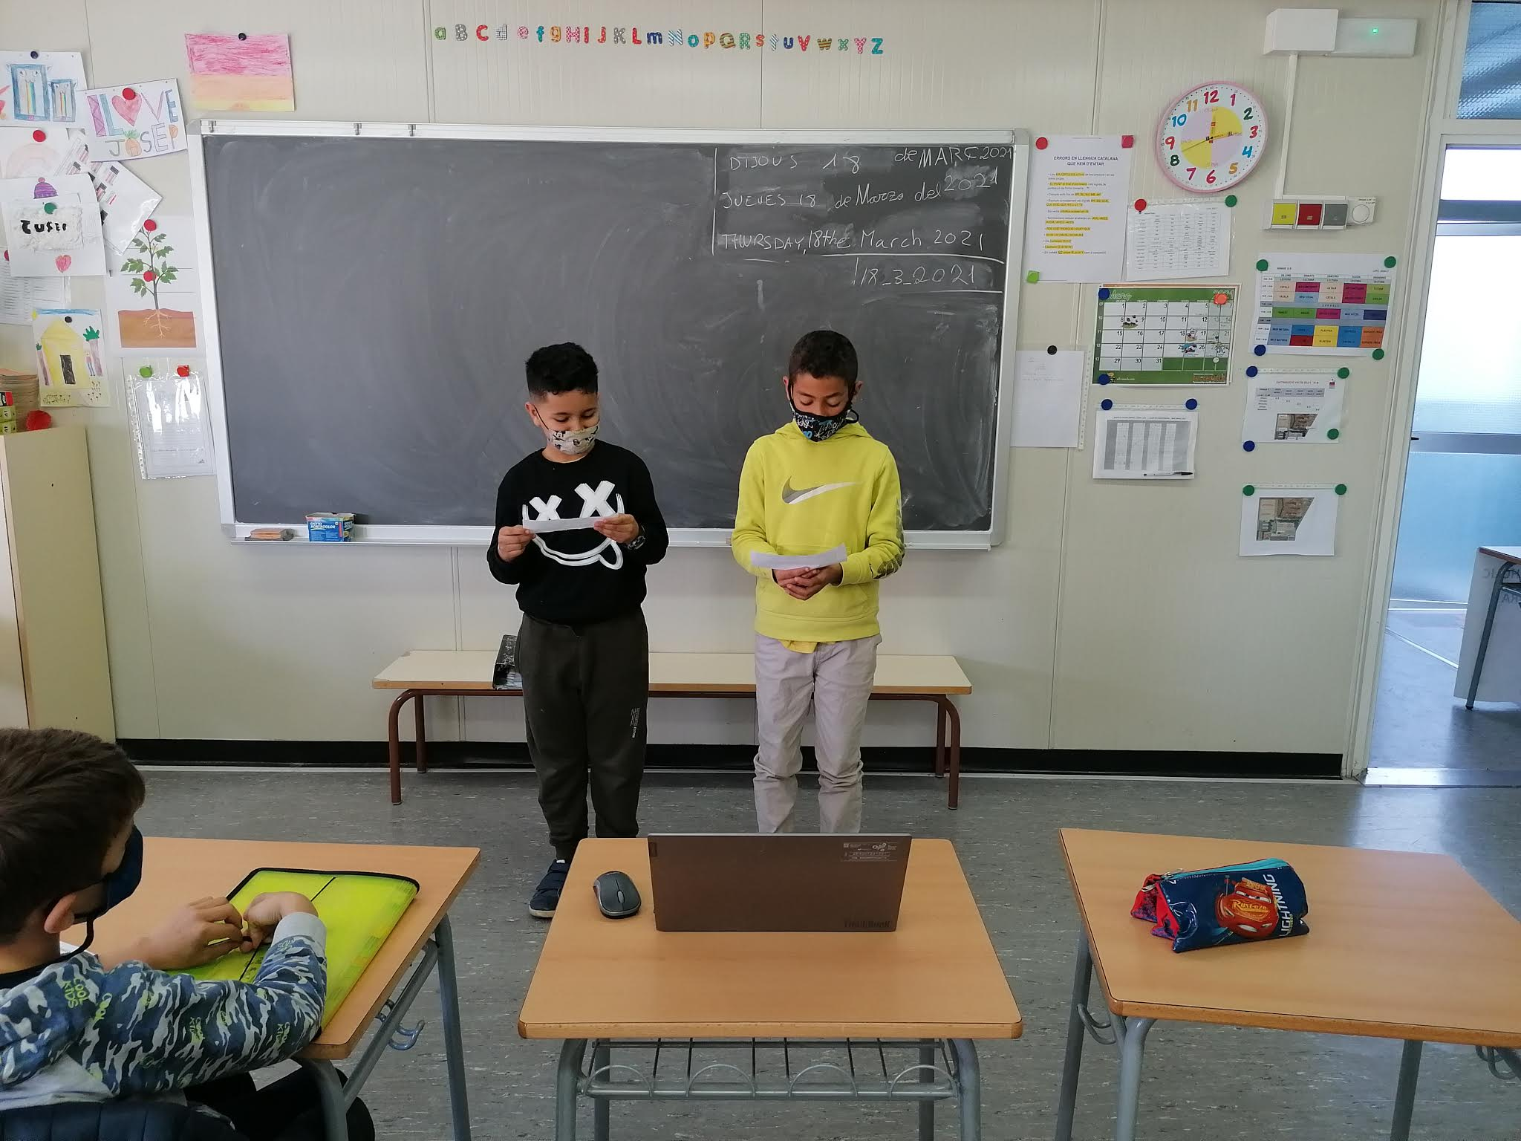
SESSION 10
Exposing their research to other students in the school. Through a video conference, students will explain Ramon Folch’s project to other students at the school.

Slide 13
ASSESSMENT- TEACHER

Slide 14
AUTOASSESMENT – PUPILS

Slide 15
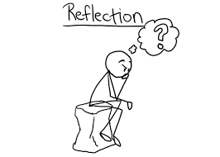
REFLECTION ON THE PROJECT
Teacher will evaluate the teaching process. Adequacy of teaching materials and resources, distribution of space and timing .
The opinion of the students will be taken into account.

